Slide 1

Decoding Lightness in Primate Visual Cortex
David H. Brainard, Douglas A. Ruff, & Marlene R. Cohen

Slide 2
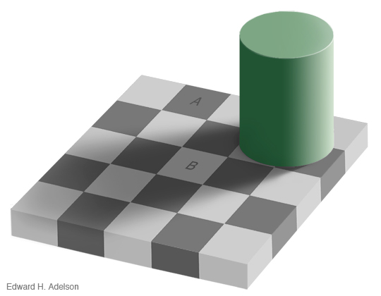
Lightness is not luminance
Checks A and B have the same luminance but different perceived lightness
http://web.mit.edu/persci/people/adelson/checkershadow_illusion.html

Slide 3
Lightness is not luminance
Checks A and B have the same luminance but different perceived lightness
http://web.mit.edu/persci/people/adelson/checkershadow_illusion.html

Slide 4
Such effects support perception of intrinsic object properties
Luminance reaching eye is illumination irradiance times surface reflectance.

Slide 5
Such effects support perception of intrinsic object properties
The same luminance reaches the eye from A and B, but illumination is perceived to be different

Slide 6
Such effects support perception of intrinsic object properties
Lightness appears to be correlated with surface reflectance

Slide 7
Lightness is not explained by local contrast coding

Slide 8
Lightness is not explained by local contrast coding
After Gilchrist, 2006; Gilchrist & Radonjić, 2010

Slide 9
Lightness is not explained by local contrast coding
After Gilchrist, 2006; Gilchrist & Radonjić, 2010

Slide 10
Our broad long-term goal: understand the cortical representation of lightness

Slide 11
Outline for today
Describe psychophysical experiment that quantifies a contextual lightness effect.
Measure multiunit responses in monkey V1 and V4 to same stimuli, using implanted multi-electrode arrays.
Build a decoder that predicts stimulus luminance from multiunit responses.
Link the decodings to the psychophysical effects.

Slide 12


Step 1: Simplify stimuli to ‘paint’ versus ‘shadow’ checkerboards
Paint Checkerboard
Shadow Checkerboard
Probe disks placed at center of 5 by 5 checkerboards.
Each of the 25 corresponding checks has same average luminance in
the paint and shadow checkerboards.
Probe disks have same local contrast as well as luminance matched broader
context.
After Hillis & Brainard, 2007

Slide 13
Step 2: Quantify the perceptual lightness effect for these stimuli
Observer fixates center of LCD display.
On each trial, two checkerboards with probe disks presented side by side.
Checkerboards are 3.5° by 3.5° and centered at +/- 3.5°.
Observer indicates which checkerboard contains the lighter probe.
Paint/shadow trials intermixed with paint/paint control trials.
Staircase procedure adjusts probe intensities.

Slide 14
Let’s try some trials

Slide 15
Let’s try some trials

Slide 16
Let’s try some trials

Slide 17
Basic psychophysical data
Reference probe disk in the paint checkerboard with luminance 0.5 (green mark)
Comparison disks presented in shadow checkerboard.
Data (red points) are fraction that the comparison was judged lighter.
Data fit with cumulative normal (red curve)
We extract the point of subjective equality (PSE) as the comparison luminance judged lighter 50% of the time (red mark).
Makes sense: probe disk of equal luminance seen in shadow looks lighter, so PSE is lower than reference luminance

Slide 18
Basic form of psychophysical data, one subject
Reference probe disk in the paint checkerboard with luminance 0.5 (green mark)
Comparison disks presented in shadow checkerboard.
Data (red points) are fraction that the comparison was judged lighter.
Data fit with cumulative normal (red curve)
We extract the point of subjective equality (PSE) as the comparison luminance judged lighter 50% of the time (red mark).
Makes sense: probe disk of equal luminance seen in shadow looks lighter, so PSE is lower than reference luminance

Slide 19
Basic psychophysical data
Reference probe disk in the paint checkerboard with luminance 0.5 (green mark)
Comparison disks presented in shadow checkerboard.
Data (red points) are fraction that the comparison was judged lighter.
Data fit with cumulative normal (red curve)
We extract the point of subjective equality (PSE) as the comparison luminance judged lighter 50% of the time (red mark).
Makes sense: probe disk of equal luminance seen in shadow looks lighter, so PSE is lower than reference luminance

Slide 20
Basic psychophysical data
Reference probe disk in the paint checkerboard with luminance 0.5 (green mark)
Comparison disks presented in shadow checkerboard.
Data (red points) are fraction that the comparison was judged lighter.
Data fit with cumulative normal (red curve)
We extract the point of subjective equality (PSE) as the comparison luminance judged lighter 50% of the time (red mark).
Makes sense: probe disk of equal luminance seen in shadow looks lighter, so PSE is lower than reference luminance

Slide 21
Basic psychophysical data
Reference probe disk in the paint checkerboard with luminance 0.5 (green mark)
Comparison disks presented in shadow checkerboard.
Data (red points) are fraction that the comparison was judged lighter.
Data fit with cumulative normal (red curve)
We extract the point of subjective equality (PSE) as the comparison luminance judged lighter 50% of the time (red mark).
Makes sense: probe disk of equal luminance seen in shadow looks lighter, so PSE is lower than reference luminance.

Slide 22
Data obtained for multiple reference probes placed in both paint and shadow
Probe in paint; ref luminance 0.25
Probe in paint; ref luminance 0.50
Probe in paint; ref luminance 0.75
Probe in shadow; ref luminance 0.25
Probe in shadow; ref luminance 0.50
Probe in shadow; ref luminance 0.75

Slide 23
Summary of paint/shadow lightness effect, one subject
Intercept of Fit Unity Slope Line: -0.08
Shadow Checkerboard Disk Luminance
Paint Checkerboard Disk Luminance

Slide 24
Summary of paint/shadow lightness effect

Slide 25
Summary of paint/shadow lightness effect

Slide 26
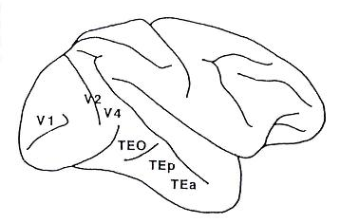
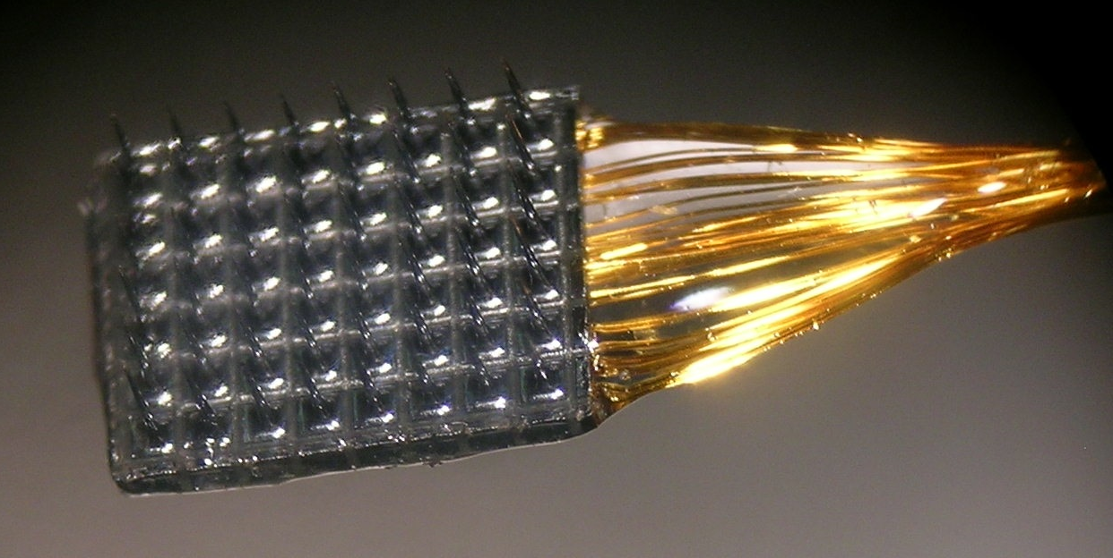
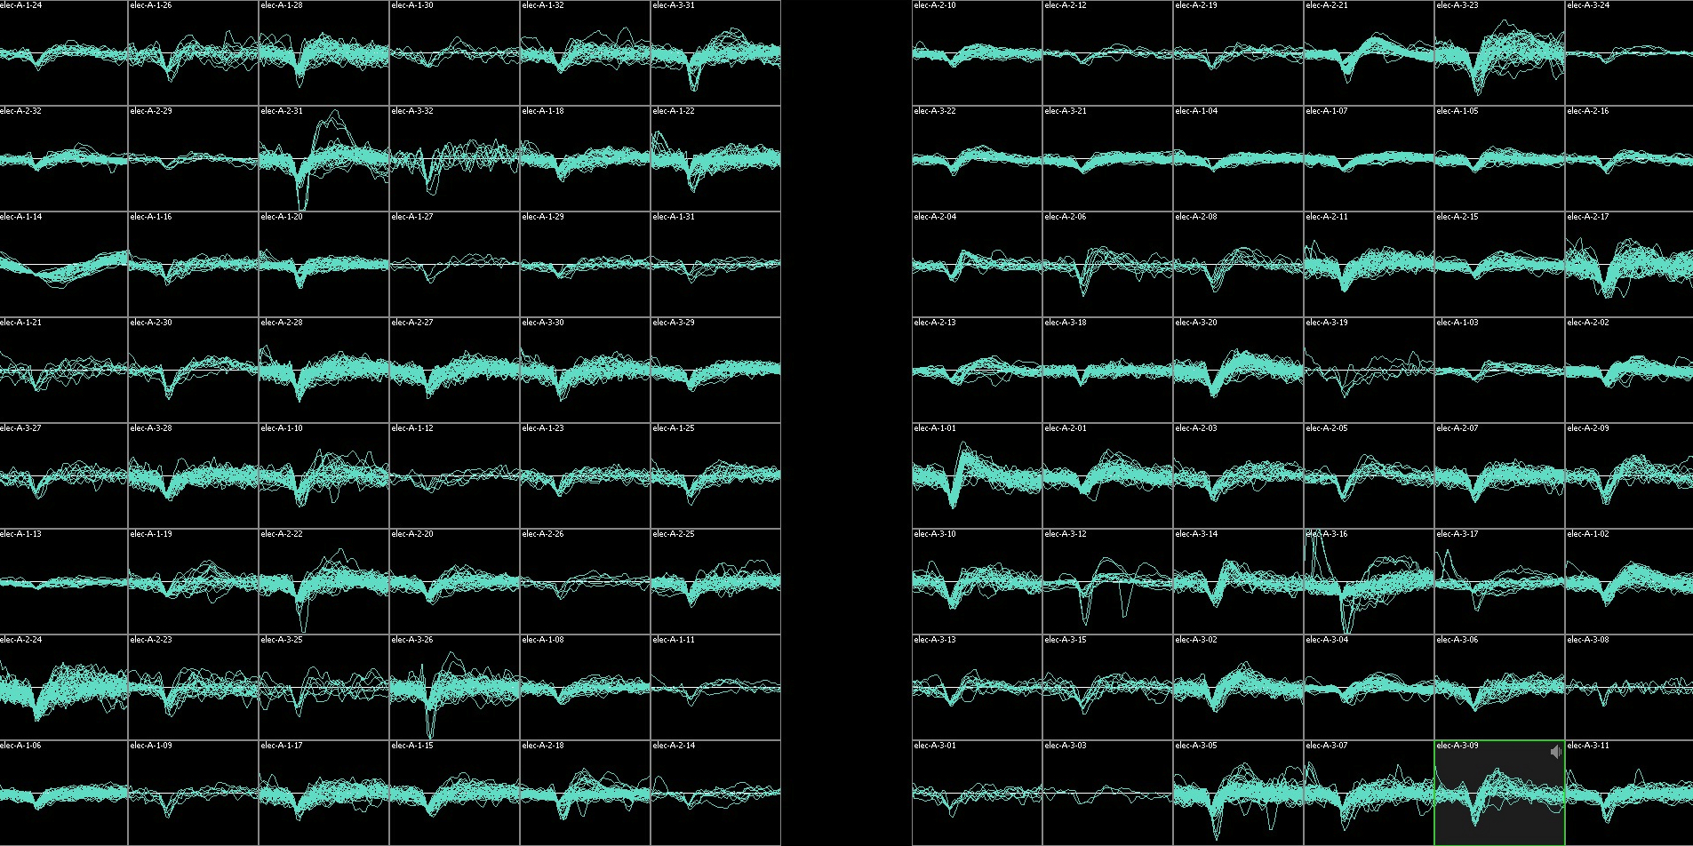
Chronic array recordings
Chronic array recordings
1 mm
Notes:
26
While the monkeys performed that task, we recorded from cortex with chronic array recordings. we implanted two small utah arrays like the one shown here into cortex.
For this project, we placed one array in V4 in both hemispheres of one monkey. V4 is a mid level visual area in the ventral processing stream where previous work has demonstrated that both the rates and correlation structure of neurons is modulated by attention.
Here im showing example RFs centers from the two arrays from a previous study

Slide 27
Physiology methods
Two monkeys, one with bilateral V4 arrays (6 by 8 electrodes each) and the other with a single V1 array (10 by 10 electrodes).
Monkeys perform fixation task while a single checkerboard is presented on each trial.
Both paint and shadow checkerboards presented, with probe disk luminances between 0.2 and 1.0 (re display max).
A variety of stimulus sizes (3°-27° mostly 8°-12° checkerboards) and locations (2°-3° V1; 0.5°-2° V4) were tested, generally the checkerboards were centered on RFs covered by electrode arrays.
Semi-automated spike sorting.

Slide 28
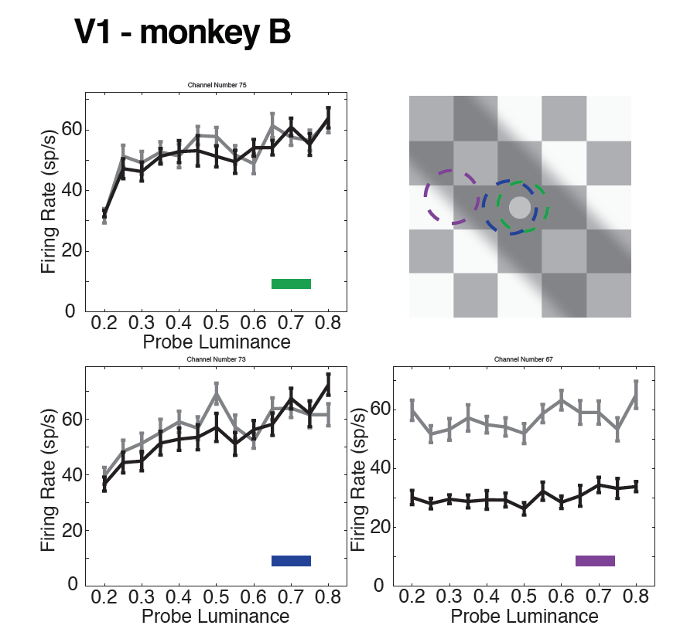
Sample single channel data, V1, monkey BR
Paint in paint
Probes In shadow

Slide 29
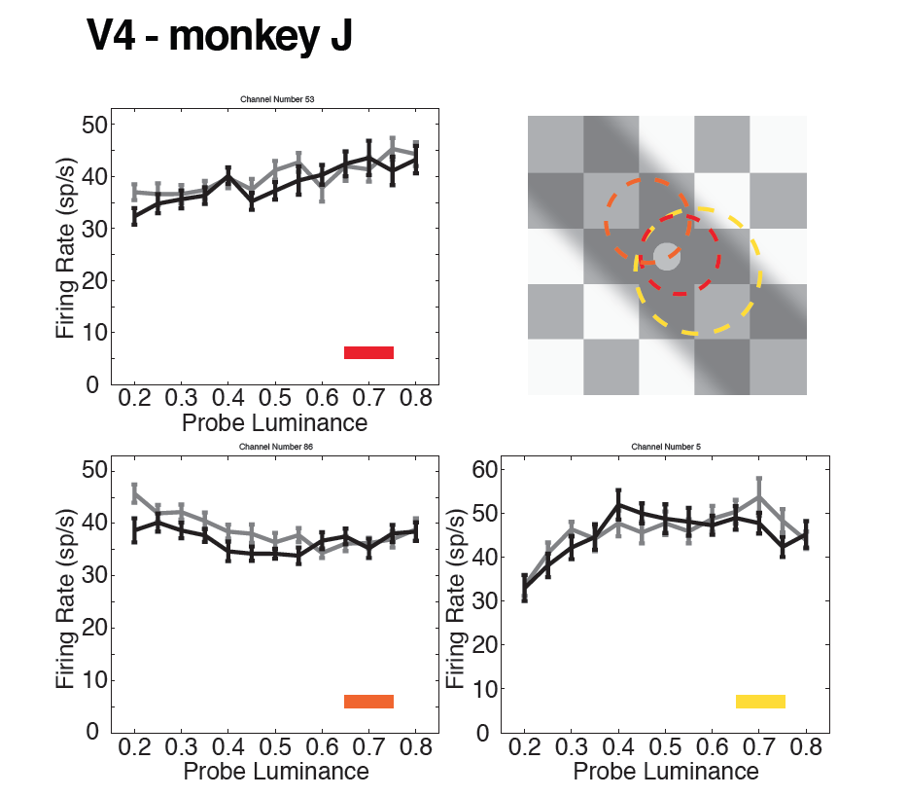
Sample single channel data, V4, monkey JD
Paint in paint
Probes In shadow

Slide 30
Analysis: build a decoder for stimulus luminance
Probe luminances for M trials
(typically 100s of trials)
Use regression to find weights that best predicts probe luminances from multiunit responses.
Decoding weights are found using both paint and shadow trials (biases decoder towards predicting same luminance for each type of checkerboard).
Leave-one-out method used: find decoding weights for M-1 trials and predict the left out luminance with those weights.
Regression finds weights
N multiunit responses for each
trial (~90 multiunits)

Slide 31
Example decoding (V1)

Slide 32
Some more decodings
V1
V1
V4
V4

Slide 33
From decoding to predicting pysychophysical PSEs

Slide 34
Comparison: V1 decoding, V4 decoding, psychophysics
V1
V4
Psychophysics
Inferred Intercept
Session (nominal)

Slide 35
V1/V4 difference is not obviously due to differences in luminance decoding quality
V1
V4
Inferred Intercept
Decode Luminance Range

Slide 36
Summary/Discussion
Population decoding does a reasonable job of predicting stimulus luminance from V1/V4 responses.
V4 decoding across paint and shadow checkerboards is consistent with lightness psychophysics, while V1 decoding is not.
Things we are thinking about: stimulus size/location/species effects (across V1/V4, across human and monkey); electrode sampling effects; would like data from a second monkey in both V1 and V4; to what degree can we classify paint versus shadow trials in V1 and V4?

Slide 38
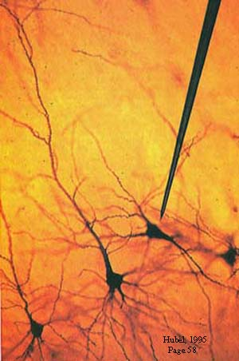
Studying the neural basis of perception

Slide 39
Chronic array recordings
Receptive field centers
Elevation
1 mm
Azimuth
6x8 grid of electrodes in each hemisphere of V4
400 microns between adjacent electrodes

Slide 40
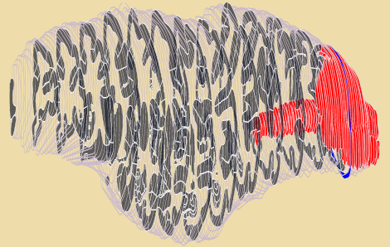
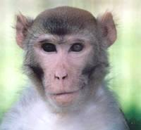
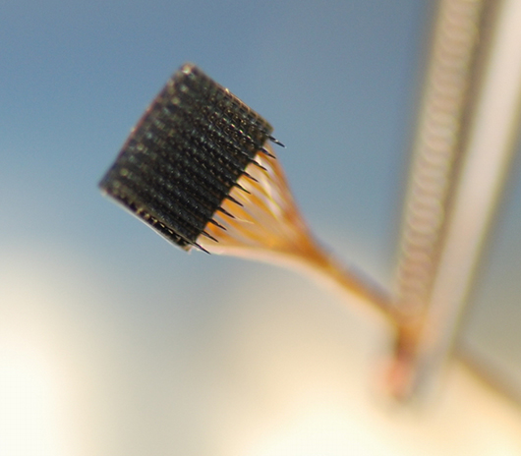

Slide 41
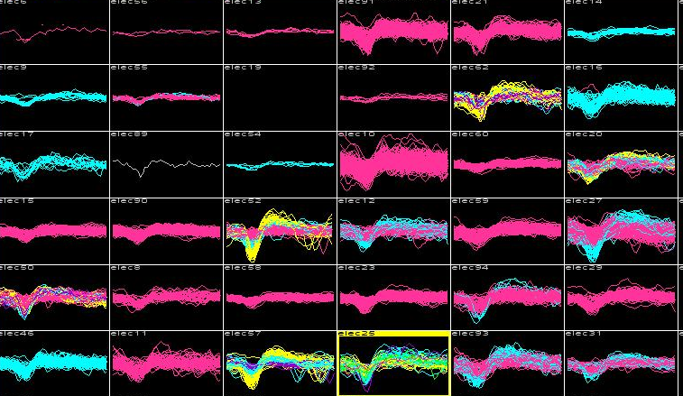

Slide 42
